Slide 1
Models with Default values

Slide 2
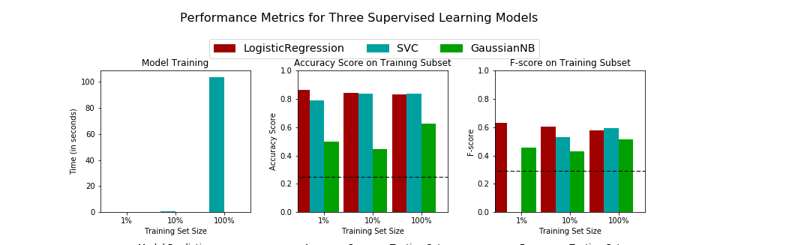
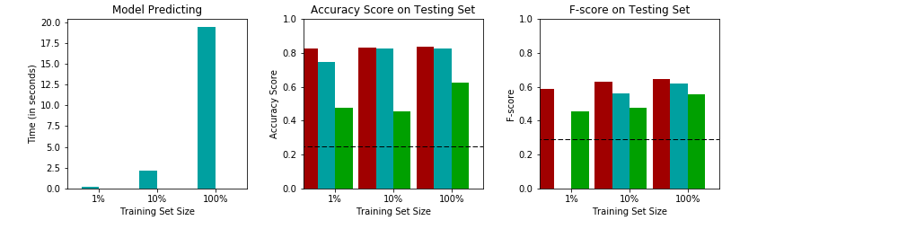
Best Based on (100% Training) | Acc | F Score | Time Training + Predict
Training | SVC | SVC | 100 due to SVC
Testing | Logistic | Logistic | 17.5 due to SVC

Slide 3
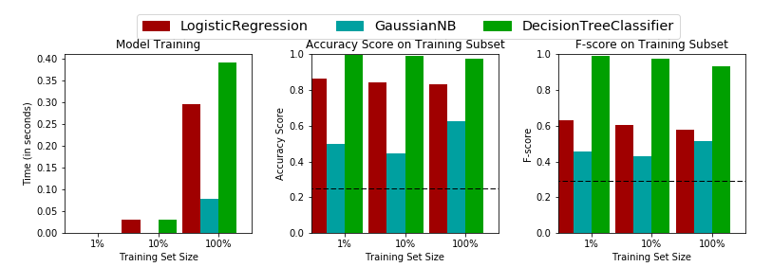
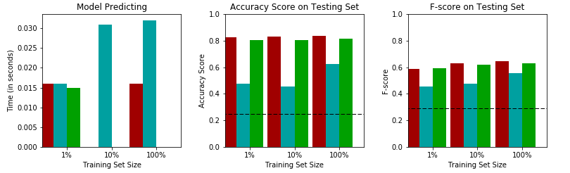
Max Depth None
Best Based on (100% Training) | Acc | F Score | Time Training + Predict
Training | DT | DT | < 1 sec
Testing | Logistic | Logistic | < 1 sec

Slide 4
Models with Improved Parameters

Slide 5
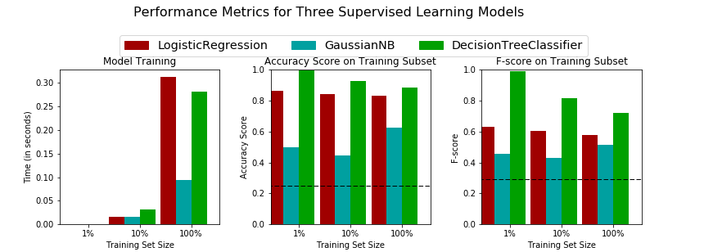
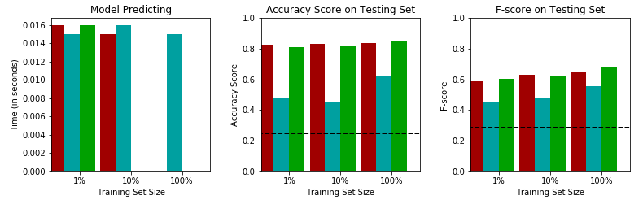
Max Depth 15

